Slide 1

L.L.A.M.A. Inc. (Libraries, Life, and Medical Assistance)
Empowering communities with knowledge and care

Slide 2
L.L.A.M.A Inc. (Libraries, Life, and Medical Assistance)
A multifaceted company that helps people in different ways.

Slide 3


Video Game Library & Sales
Jonathan Hardwick
Brenda Beach
Support Spot
Brittany Smith
Justin Graves

Slide 4

Video Game Library & Sales
Sam has an extensive collection of video games and consoles, and they want to create a list of their items to determine their potential worth.

Slide 5

Video Game Library & Sales
User can create an account
Can create a library of all video games, consoles, and peripherals.

Slide 6
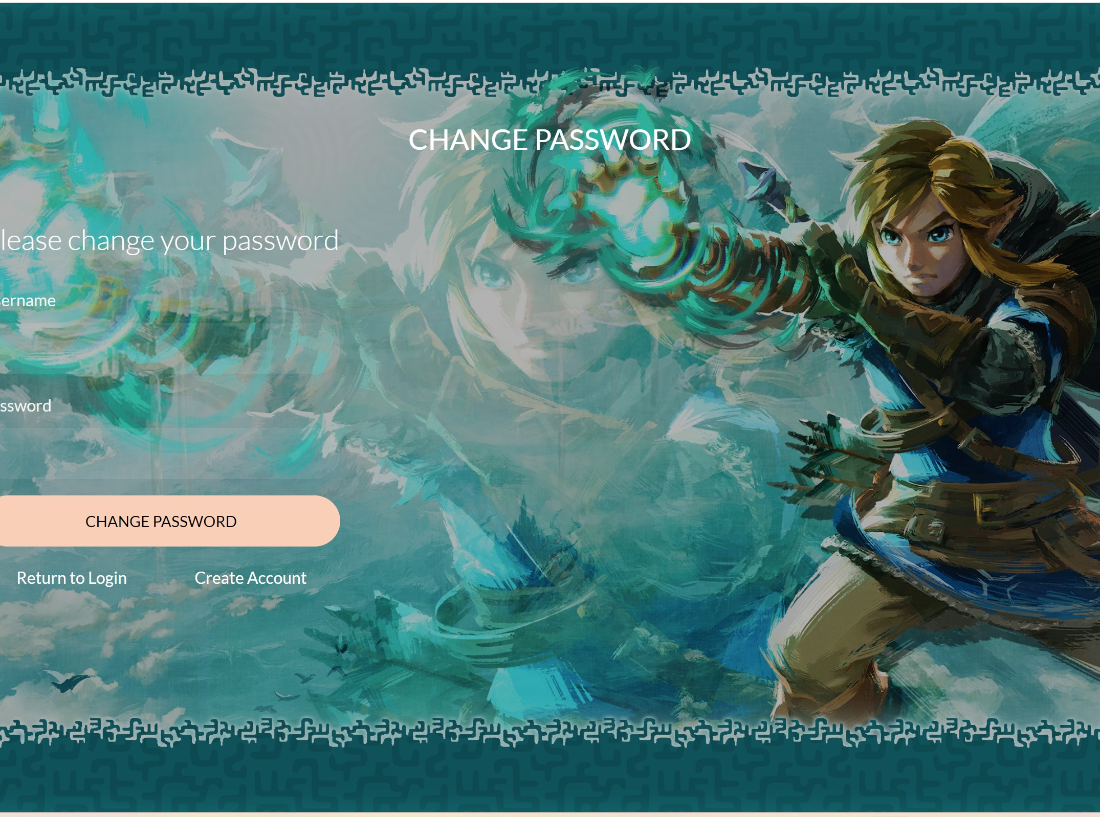
Video Game Library & Sales
If User forgets their password, they can change it.
The user can also change their username under their account information.

Slide 7
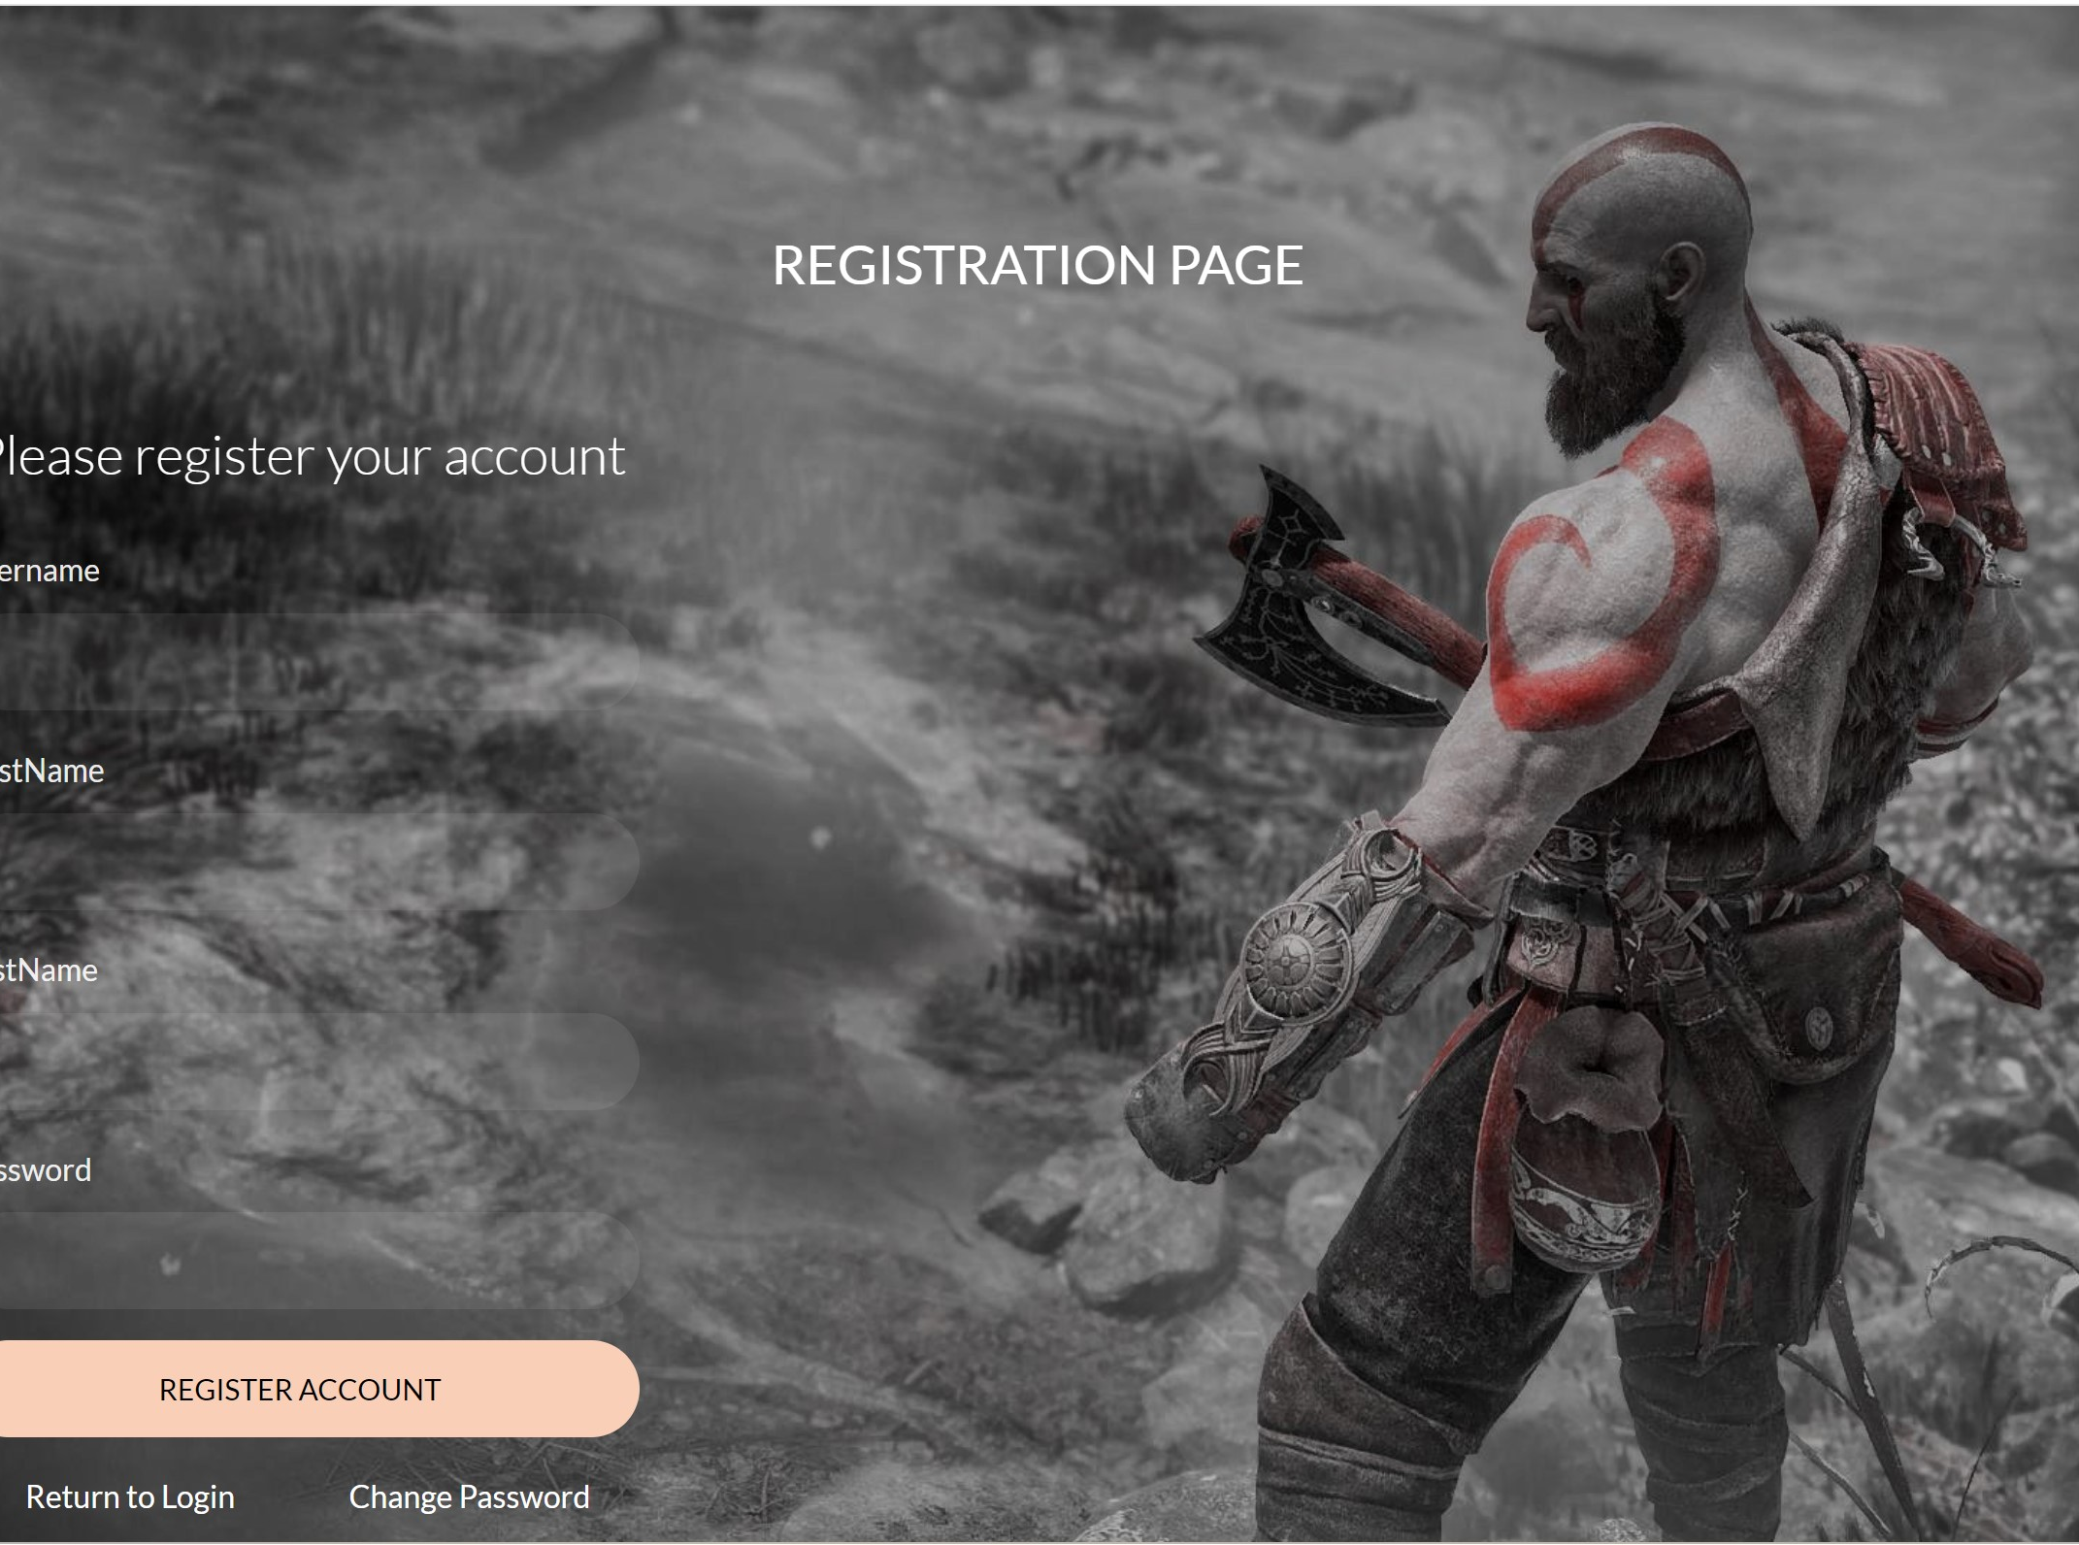
Video Game Library & Sales
The program will scrape other websites to get the possible value of the item.
The price will then be displayed on the screen.

Slide 8

Video Game Library & Sales
As a future update, we plan on having it where the user can sell their item through the website.

Slide 9
Support Spot
Insert problem we will solve along with personas

Slide 10

The way to get started is to quit talking and begin doing.
Walt Disney

Slide 11



Summary
With PowerPoint, you can create presentations and share your work with others, wherever they are. Type the text you want here to get started. You can also add images, art, and videos on this template. Save to OneDrive and access your presentations from your computer, tablet, or phone. ​

Slide 12

Questions?

